Slide 1

Solo Project: Personal Yoga Application
˃ NSA Week 7
Aysha Marty
The brief
My Solution
API
Testing
Front End
DevOps
Demonstration
Summary

Slide 2
The brief
Solo Project
Full-stack application
Technologies
CRUD manipulation
The brief
My Solution
API
Testing
Front End
DevOps
Demonstration
Summary
Notes:
The brief was to create a full stack application, utilising all the technologies we’ve learned here at QA. The application should allow the user to manipulate two tables with the full ability to create, read, update and delete objects within those tables.

Slide 3
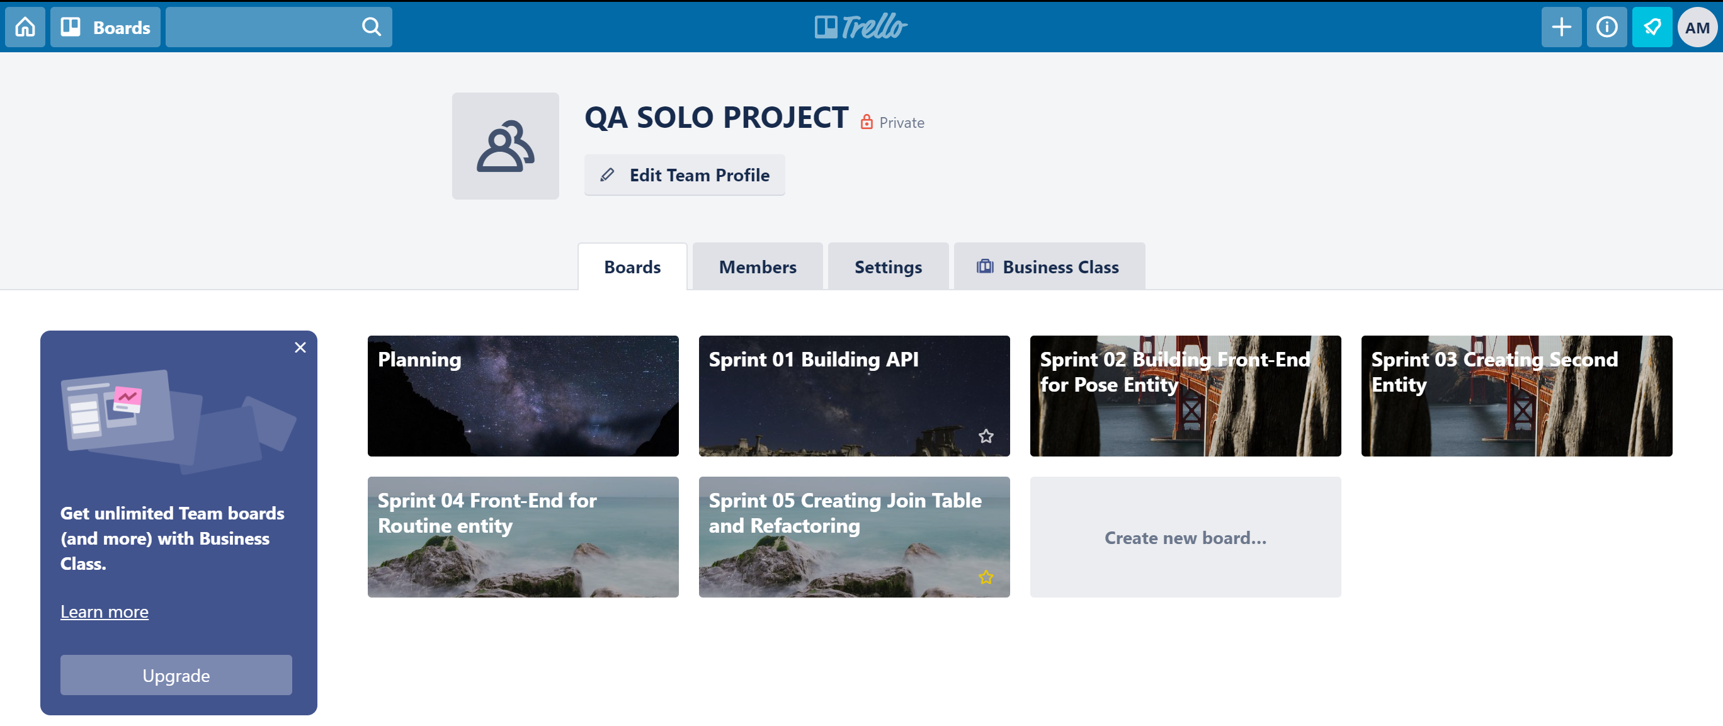
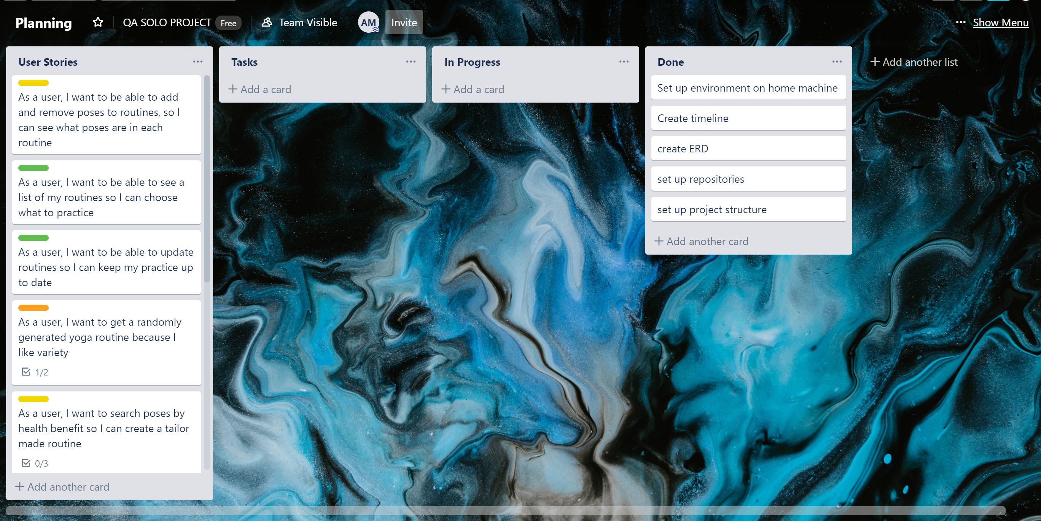
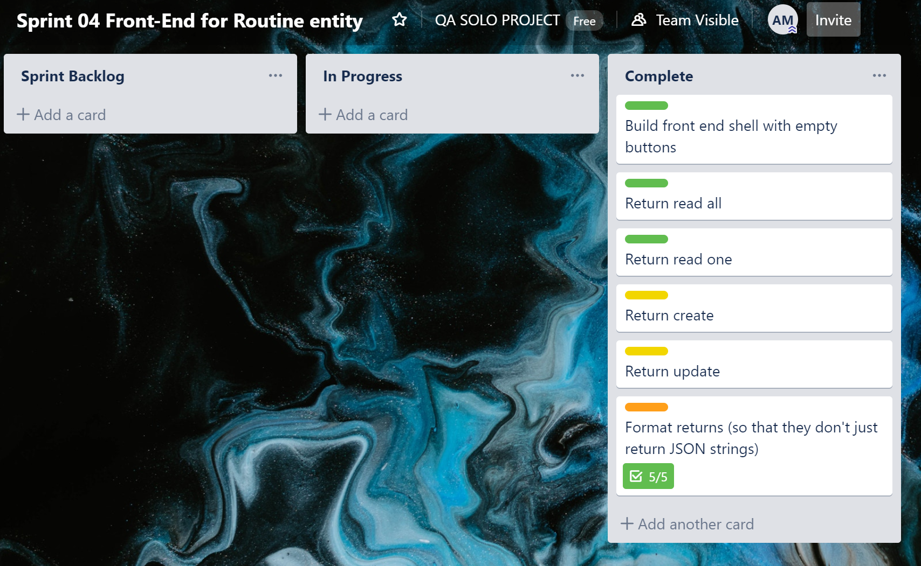
My solution
The brief
My Solution
API
Testing
Front End
Demonstration
DevOps
Summary

Slide 4
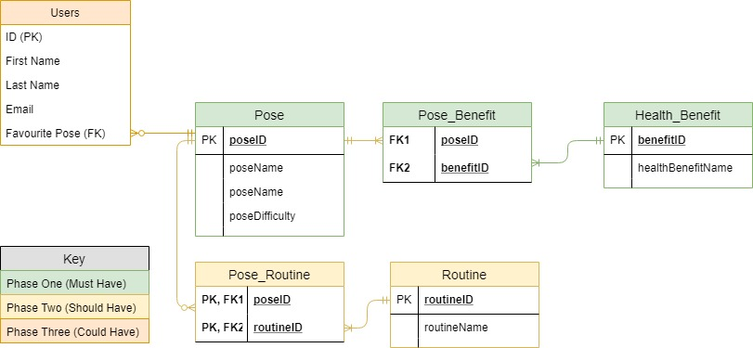
My solution
The brief
My Solution
API
Testing
Front End
Demonstration
DevOps
Summary
Notes:
This is the initial Entity Relationship Diagram that I set out with. I colour coded it based on the importance of the feature, and so the order in which I would build the application’s functionality. Green being, must have, yellow being should have, and orange being could have

Slide 5
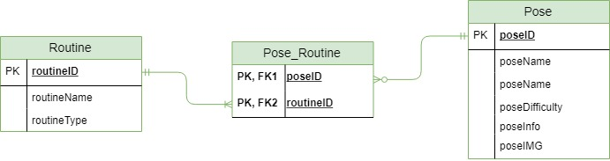
My solution
The brief
My Solution
API
Testing
Front End
Demonstration
DevOps
Summary
Notes:
In the end, I only managed to build phase one, and I actually ended up changing the focus of the application. I initially decided that first many-to-many would be poses and health benefits, so that you could generate a routine based on whether you wanted to work on flexibility, strength or relaxation – that sort of thing. When we started designing these, we had only just begun learning java, so had no real way of visualising how it would look or be interacted with. By the time I had built the first entity, which was poses, I had a better idea of what I wanted, and decided it would be better to create a routine entity, that would have a many to many relationship with poses.

Slide 6
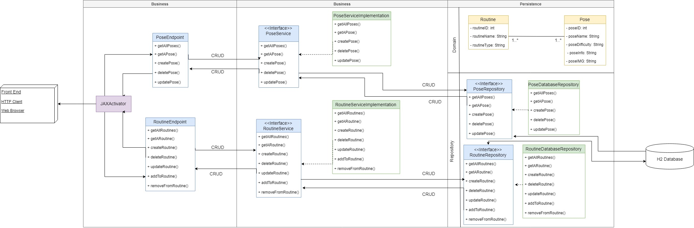
API development
The brief
My Solution
API
Testing
Front End
DevOps
Demonstration
Summary
Notes:
Week 4 was api development week – it was really cool to see everything come together that week and create this sort of living entity of a system. I left the many to many relationship until the end to put together → I wanted to make sure I had two tables working and accessible in the front end first → so I ended up commenting out all the code that required many to many → which at this point was only the routine Class’ poseSet attribute → which would be the collection of poses that would make up the routine.
I have tried to adhere to the SOLID principles wherever possible → I make use of abstractions where possible with my interfaces, attributes are private, accessible only with getters and setters, the responsibility of each class is minimised

Slide 7
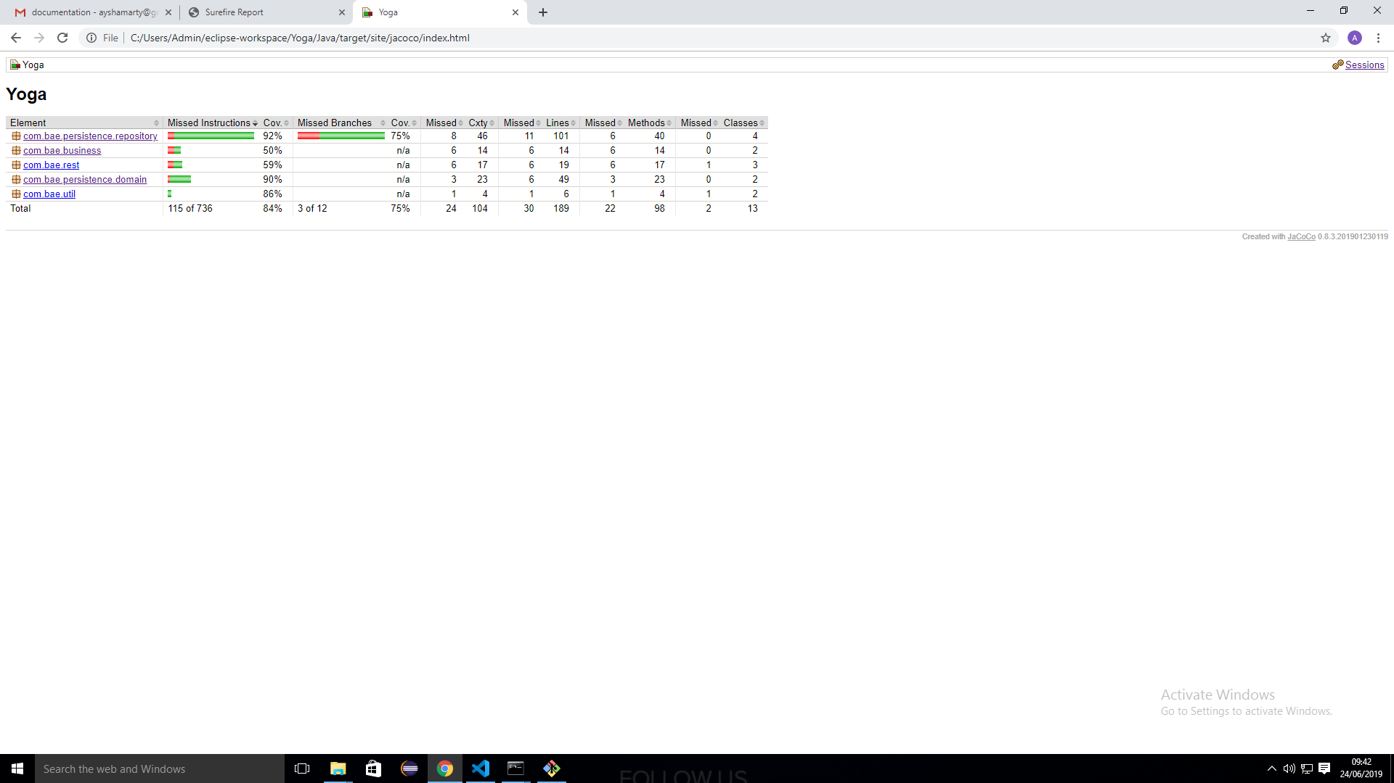
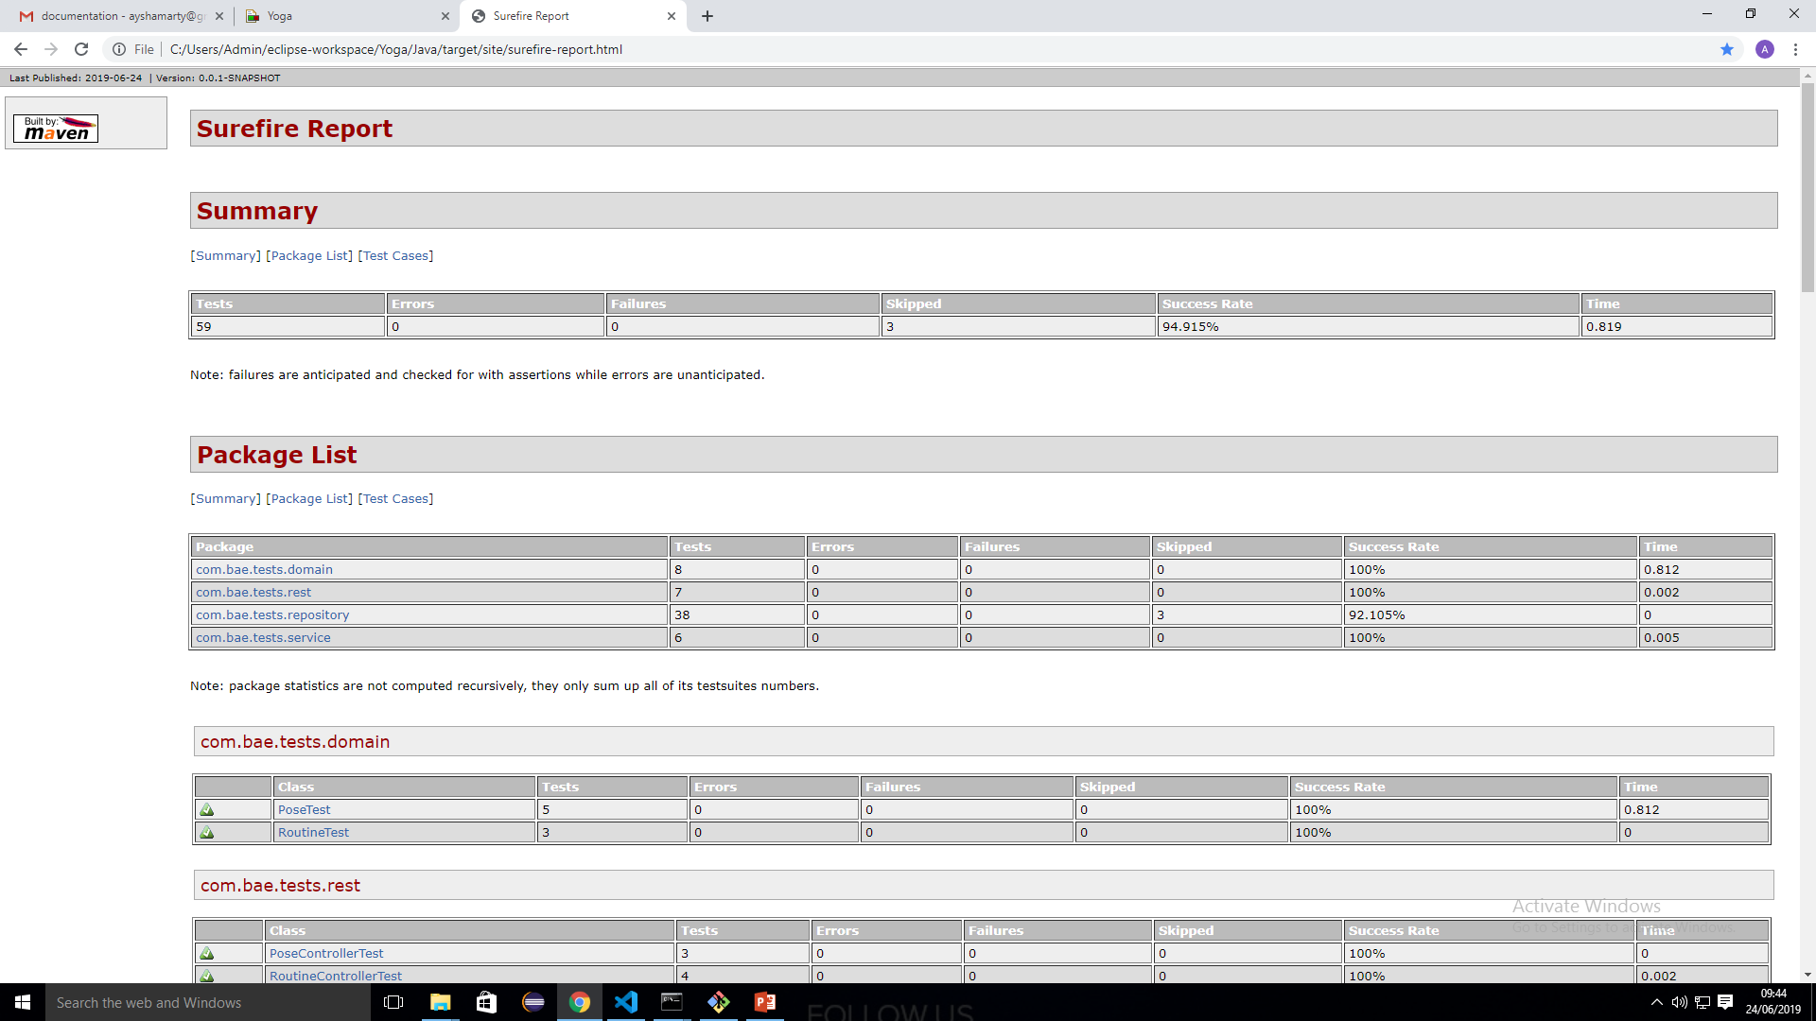
Testing: Unit
The brief
My Solution
API
Testing
Front End
DevOps
Demonstration
Summary
Notes:
Testing is context dependent, and the brief asked for 80 test coverage which I achieved.
I would have liked to get some selenium tests done to cover the front end; however I was having some issues over the weekend configuring it on my machine. At the moment the selenium tests I’ve written are @ignored, which probably isn’t great practice, but I’ve got one ready to go once I can get it working at least.

Slide 8
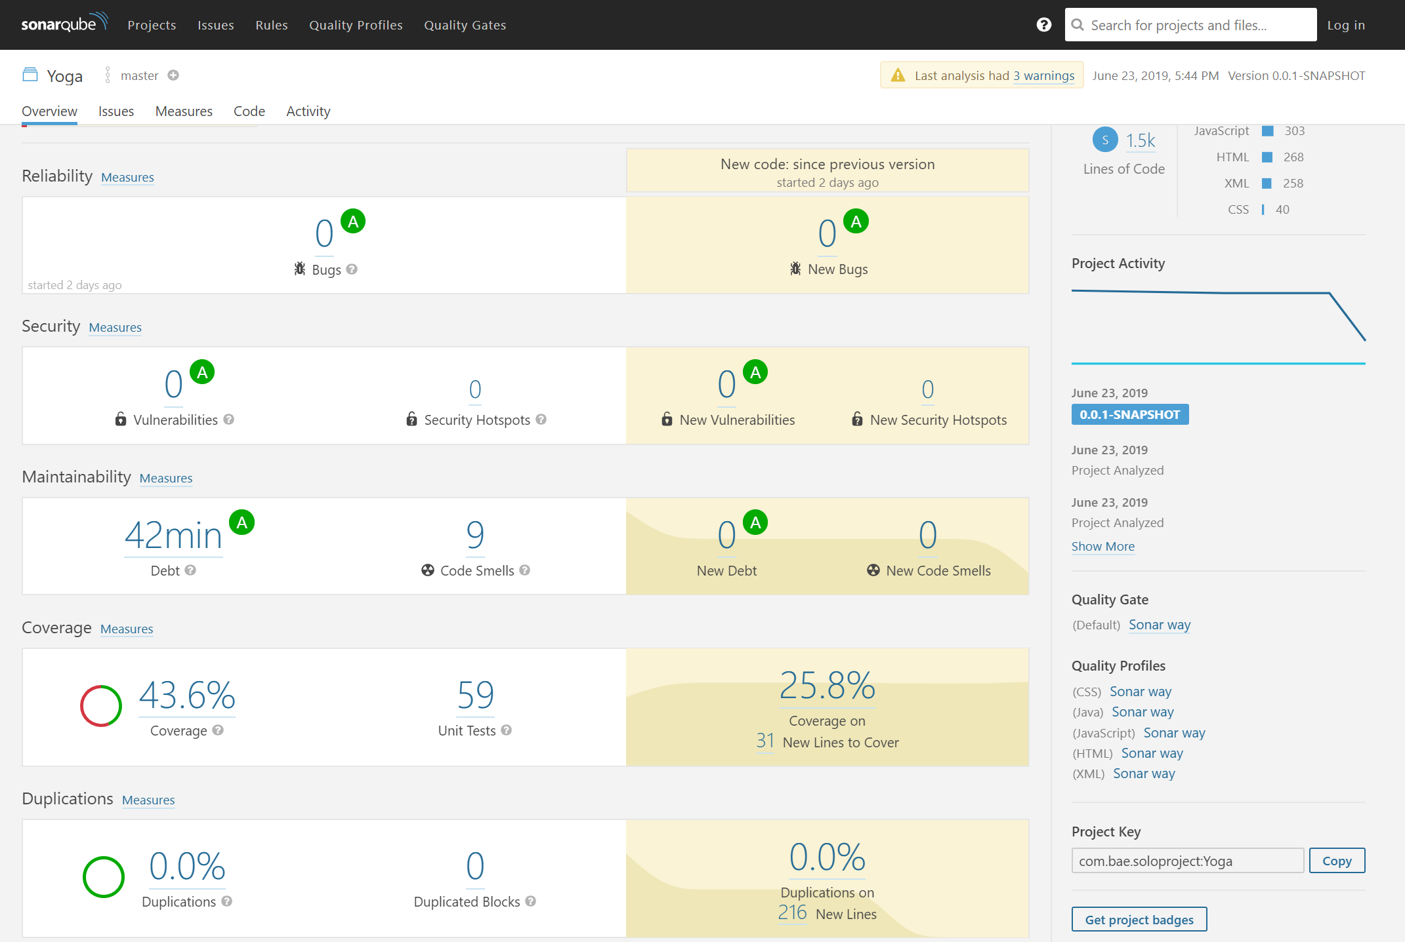
Testing: Static
The brief
My Solution
API
Testing
Front End
DevOps
Demonstration
Summary
Notes:
We covered static testing in week 3, using sonarLint, and had been taking screenshots of the bar at the bottom each refactoring period, but now we have access to SonarQube with our VM instances, I thought screenshotting that would give a better summary of my code health. I had to work on some duplications of code in my HTML – it didn’t like me repeating the navbar, so I ended up building it in a JavaScript file which was run on each of my pages. The 9 code smells that remain are things like wanting me to create constructors for my constants classes which I didn’t think was necessary, and it didn’t like some of my JS variable names → I used ‘i’ to iterate through my javascript objects a few times. Which in a future sprint I would probably refactor, as I appreciate the confusion that could cause when scaling up. It is also a bit angry at my ignored selenium test which again, I would hope to manage in the next sprint

Slide 9
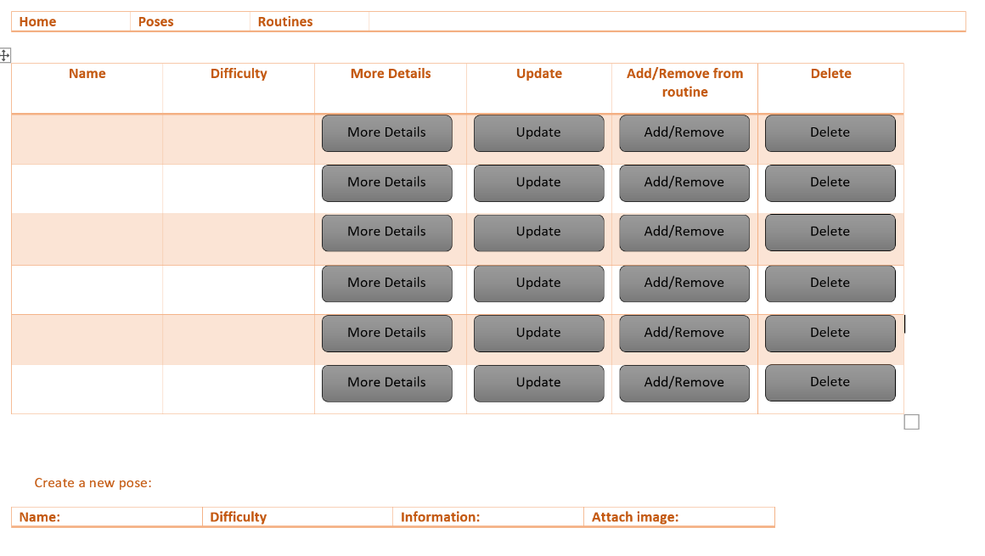
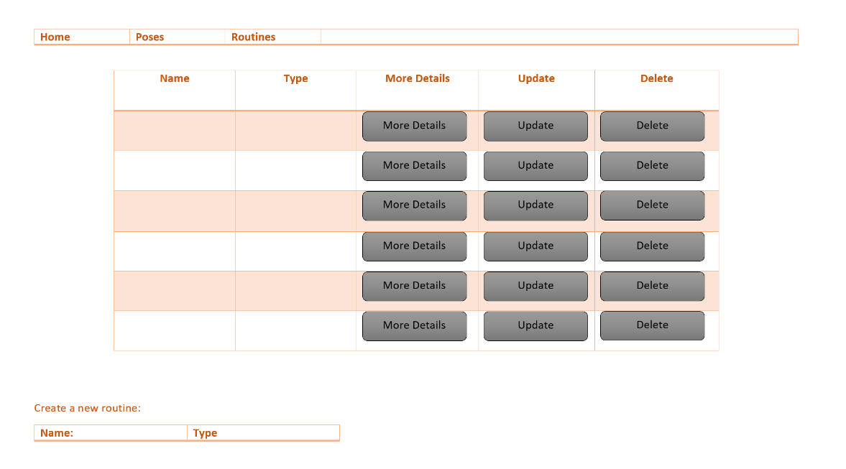
Front End: JavaScript, HTML and CSS
The brief
My Solution
API
Testing
Front End
DevOps
Demonstration
Summary
Notes:
Wireframes

Slide 10
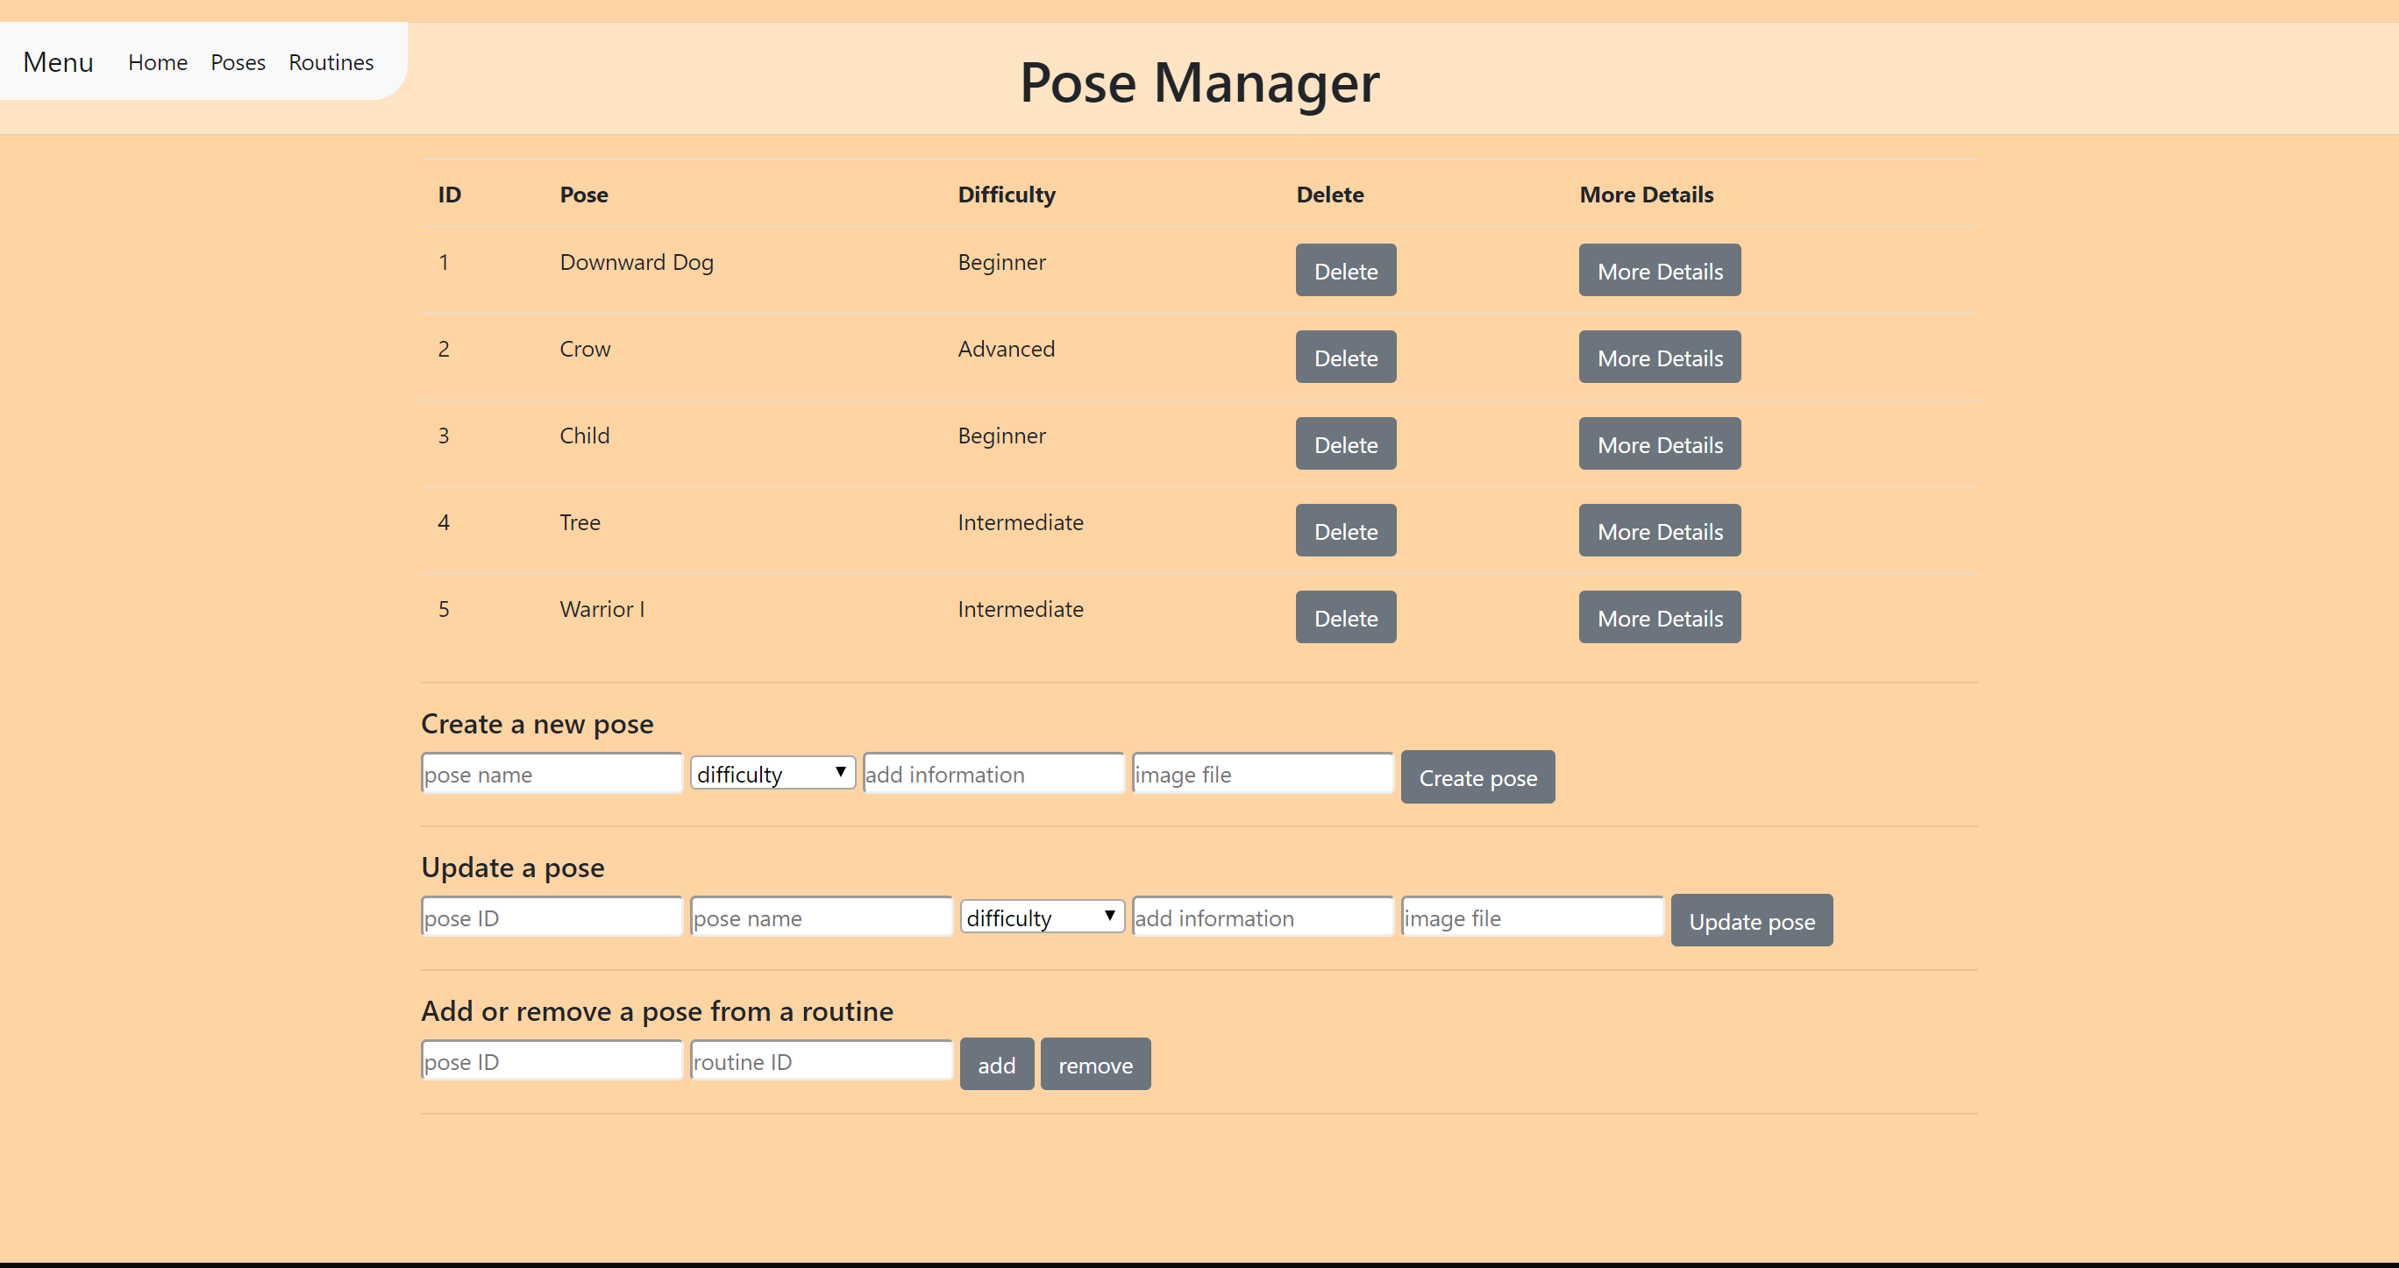
Front End: JavaScript, HTML and CSS
The brief
My Solution
API
Testing
Front End
DevOps
Demonstration
Summary
Notes:
This is what it actually looks like

Slide 11
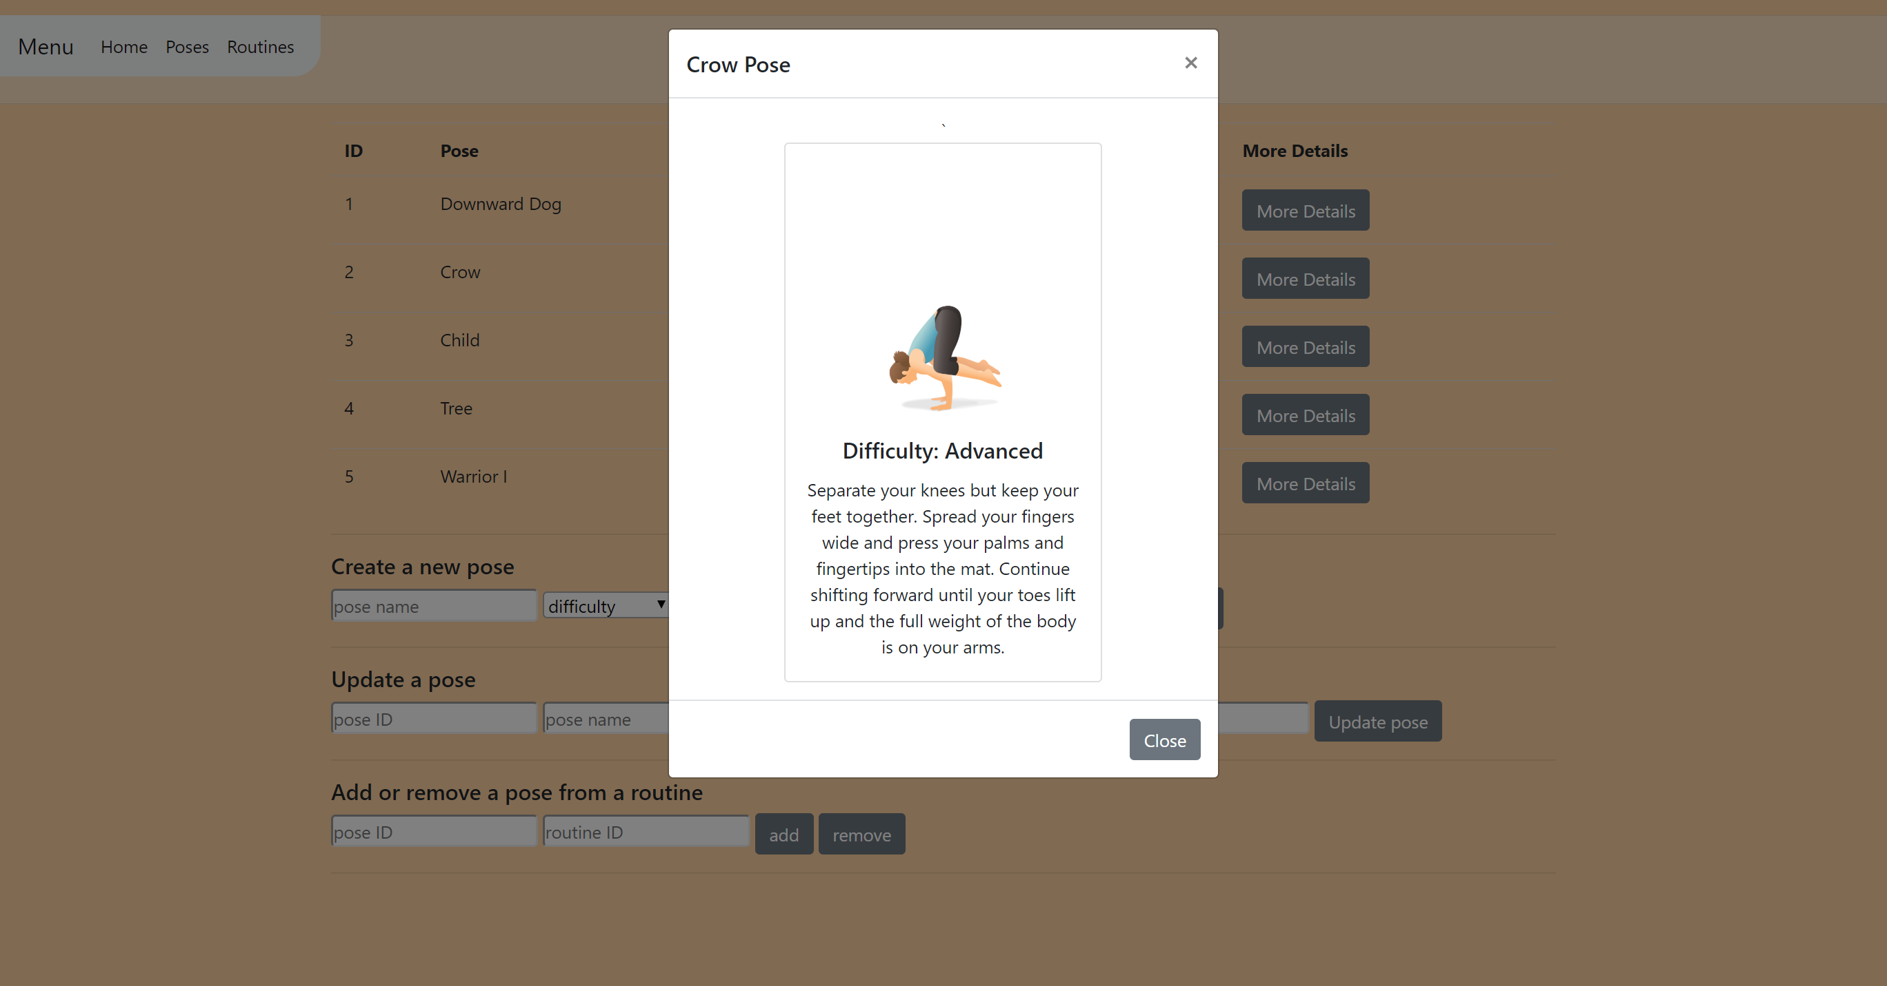
Front End: JavaScript, HTML and CSS
The brief
My Solution
API
Testing
Front End
DevOps
Demonstration
Summary
Notes:
When you press the ‘more details’ button, it triggers a Modal box to appear, and there’s a bootstrap card which I learned to make during front end week – the idea for the modal box was definitely inspired by one of the group presentations that week that had a table appear as a popup like that→ I probably wouldn’t have found out about modal boxes otherwise

Slide 12
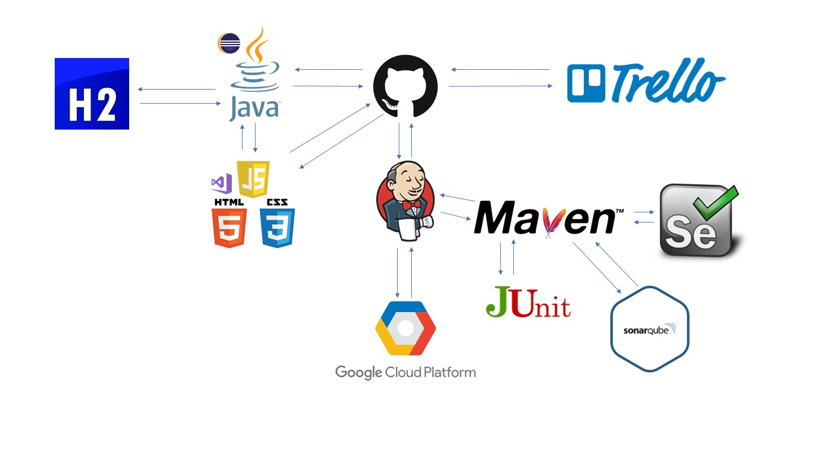
DevOps and Continuous Integration
The brief
My Solution
API
Testing
Front End
DevOps
Demonstration
Summary

Slide 13
Summary
What went well
Many-to-many relationship
UX
Test coverage and static testing
Use of CI tools
Overall journey
Improvements for the future
Project tracking
Use of version control system
Front end testing (Selenium)
UX
The brief
My Solution
API
Testing
Front End
DevOps
Demonstration
Summary

Slide 14
Demonstration
The brief
My Solution
API
Testing
Front End
DevOps
Demonstration
Summary

Slide 15
Questions and Feedback
˃ Thank you for listening

Slide 16
BAE SYSTEMS
Surrey Research Park Guildford
Surrey GU2 7YP
United Kingdom
T: +44 (0)1483 816000
F: +44 (0)1483 816144
Copyright © 2017 BAE Systems. All Rights Reserved.
BAE SYSTEMS, the BAE SYSTEMS Logo and the product names referenced herein are trademarks of BAE Systems plc.
No part of this document may be copied, reproduced, adapted or redistributed in any form or by any means without the express prior written consent of BAE Systems.
BAE Systems Applied Intelligence Limited registered in England and Wales Company No. 1337451 with its registered office at Surrey Research Park, Guildford, England, GU2 7YP.

